Slide 1

Preparing for Open Heart Surgery at Southcoast
Shaina Vickery PT, DPT, GCS
Regional Clinical Educator, Rehab Services
Ashley Lodge BS, PT, DPT
Acute Care Team Leader, Rehab Services
Notes:
Hi & Welcome to Southcoast! We are so excited you chose Southcoast and we look forward to having you here with us very soon. We hope you find this video informative as you prepare for open heart surgery. My name is Shaina Vickery and I am a physical therapist and clinical educator for rehab services. My name is Ashley Lodge and I am also a physical therapist and the Team Leader for Rehab Services here at Charlton Memorial Hospital. We are excited to take you through this presentation.

Slide 2
Cardiothoracic Surgery Team
Nursing Team
Coach
Patient
Care Coordination
PT/OT
Medical Team
Notes:
This is your cardiothoracic team with YOU at the Center!
Your “Coach” is someone you choose as your point person that you trust and know can assist you at the time of discharge to ensure you have a great and safe recovery at the next level of care.
The medical team will be your Cardiothoracic team. If other teams needs to be introduced, they will do so and you will meet them during your admission.
Your nursing team consists of your registered nurse who will be providing most of your care after your surgery and will prepare you for discharge
Your care coordinator, or case manager, specializes in discharge planning and will assist you so that you are successful at the next level of care, whether that be home or at a skilled facility.
Physical and Occupational Therapists are movement specialists that will work with you during your rehabilitation post operatively. They will progress you to the best of your ability and perform patient and family education with your family or “coach” to prepare you the best they can for discharge with the help of your nursing team.

Slide 3
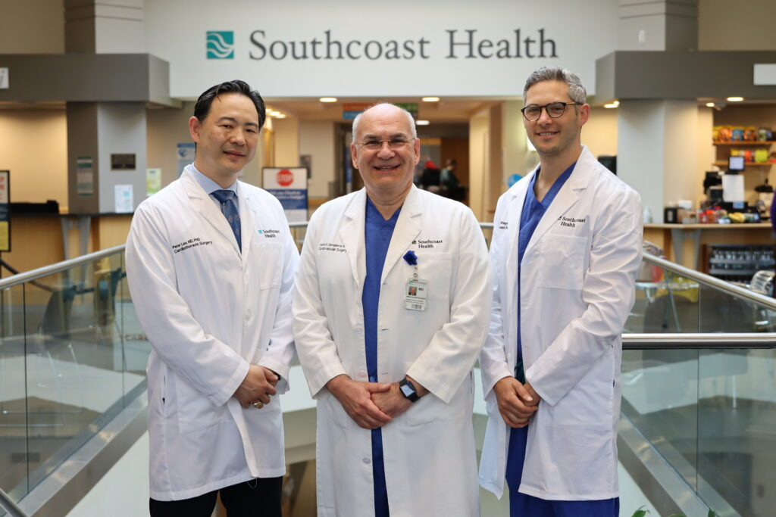
Meet the Cardiothoracic Surgeons!
Pictured (Left to Right):
Dr. Lee, Dr. Gerogiannis, Dr. Kriegel
Notes:
Meet Our Cardiothoracic Surgeons. Pictured Left to Right is Dr. Lee, Dr. Gerogiannis who is our Chief of Cardiothoracic Surgery and finally Dr. Kriegel on the far right

Slide 4
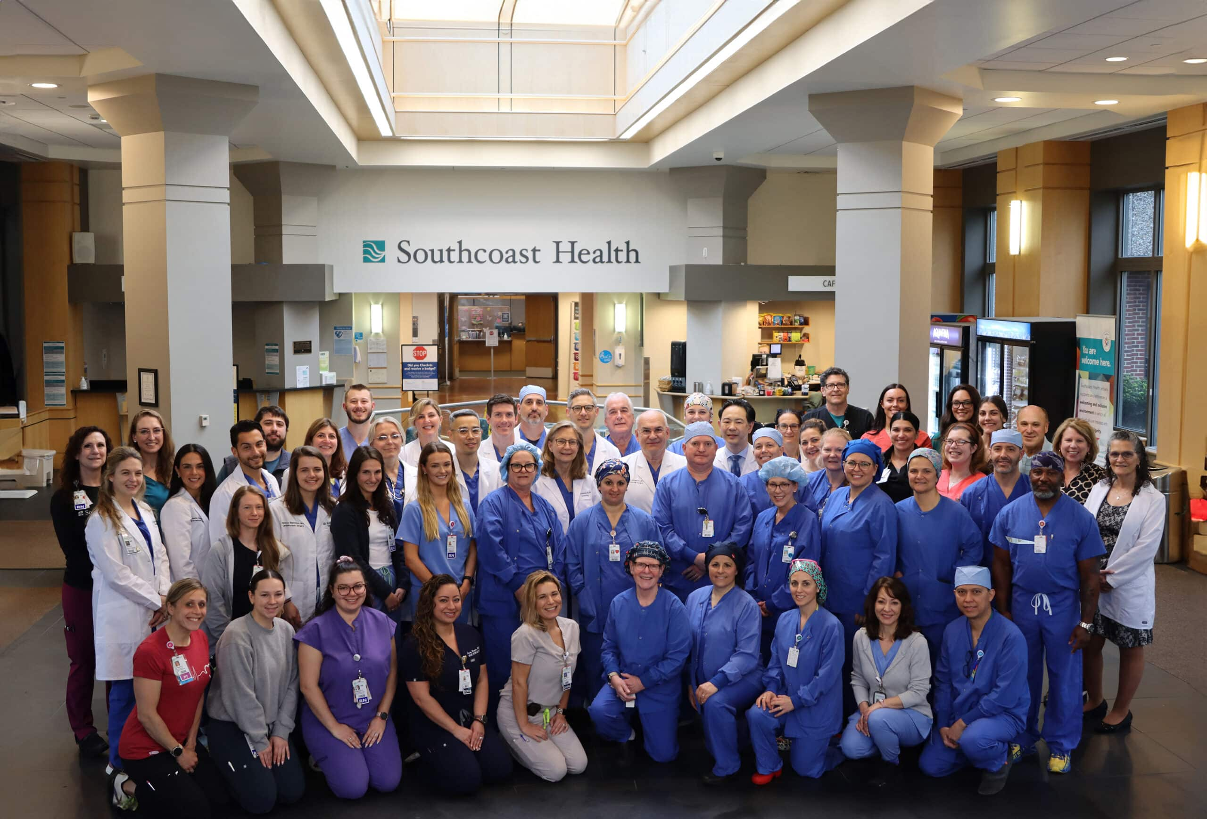
Meet some more members of the team!
Notes:
We look forward to meeting you in person but for now here are some members of our growing team!

Slide 5
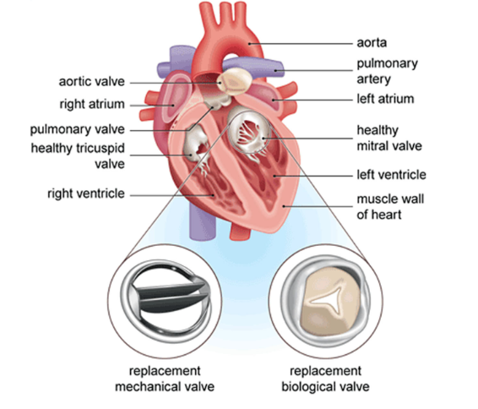
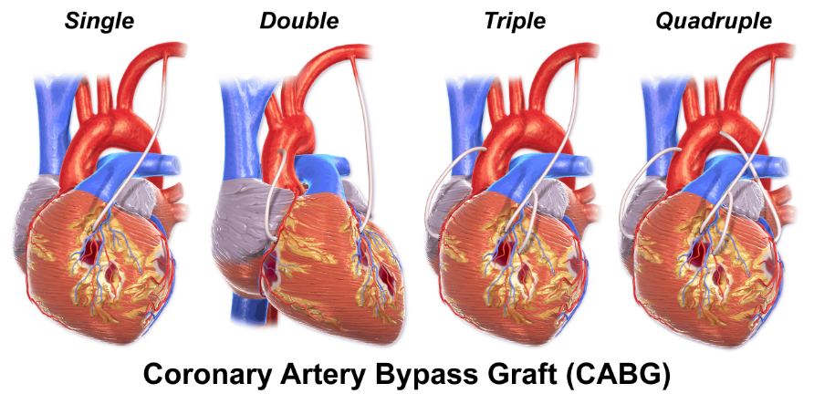
About your heart surgery
Coronary Artery Bypass Surgery (CABG)
Bypasses a blockage
Involves taking a part of a vein or artery from another area to bypass the blocked artery
After the new artery or vein is grafted, blood flows around the blocked area and again takes blood and oxygen to your heart muscle
Valve Surgery via Median Sternotomy
4 valves in your heart that act as one-way doors that allow blood to travel in and out of the heart’s chambers each time it beats
A damaged valve causes your heart to pump harder, and you may feel pain, shortness of breath or dizziness
Notes:
Open heart surgery may include a coronary artery bypass surgery or replacement of a heart valve.
A coronary artery bypass surgery often referred to as a CABG is a procedure intended to relieve the stress on your heart by creating new pathways for blood to flow.
A blockage is bypassed by taking a part of a vein or artery from another area such as the thigh. After the new artery or vein is grafted, blood will flow around the blocked area and begin taking blood and oxygen to your heart muscle once again.
If you are having valve surgery. They will take the damaged valve and replace it with a mechanical or biological valve. There are 4 valves in your heart that act as one-way doors that allow blood to travel in and out of the hearts chambers each time it beats.
A damaged valve causes your heart to pump harder and you may feel pain, shortness of breath or dizziness.

Slide 6
Cardiac Surgery Timeline
Pre-op
Day of Surgery
Home
Hospital
Watch Virtual Pre-op class
Complete Pre-op testing
Prepare your home
Admit to hospital
Have your cardiac surgery
Inpatient rehabilitation & recovery
Continue recovery & therapy at home
Follow up in 6 weeks
Notes:
This is your cardiac surgery time. We will review each step during this presentation. We are here at pre-op step number 1 which is watching this presentation. We will also review pre-op testing and how to prepare your home. We will discuss what to expect on the day of surgery, during your hospital stay and what happens when you are ready to leave the hospital.

Slide 7
What to Expect: Pre-admission Testing
Medical History & Physical
Meeting with your Case Manager
Lab work, testing & Imaging
Dental Clearance
Optional Tour of the Cardiovascular ICU
Notes:
Pre-admission testing will take place several days or weeks before your scheduled surgery and will include:
A review of your Medical history and physical
A Nursing assessment
A Review of medications including what to stop before surgery and what to take the morning of surgery
An Anesthesia interview
Completion of Surgical and anesthesia consent forms
Meeting with your cardiac surgery case manager
Lab work, testing and imaging
Dental clearance
And finally an Optional Tour of the Cardiovascular ICU

Slide 8
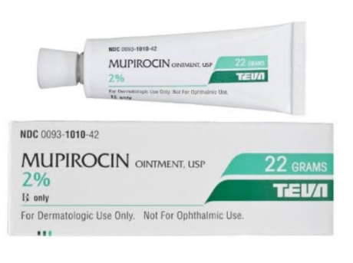

What to expect: Pre-admission Testing
Important steps to prevent infection
Mupirocin ointment is ordered and to be applied to each nostril 2x/ day for 5 days before surgery
Hibiclens wash to reduce bacteria on the skin before surgery
Specific instructions will be given to you at your pre-op visit
Wash to be completed 5 days before surgery and on the morning of surgery
Notes:
A nose swab for staph bacteria will be completed at your pre-op testing visit. Many people carry staph bacteria in their nostrils without any signs or symptoms. If you are a carrier of this bacteria this could be a source of surgical infection. All patients will be swabbed during pre-admission testing and if positive will be treated with an ointment. You will also be given hibiclens wash to reduce bacteria on the skin before surgery. You want to shower with this antimicrobial soap the night before and the morning of your surgery.
Please note: if your surgery is not elective and you need to be admitted at the time of surgery, then all pre-surgery activities will be taken care of for you.

Slide 9
What to expect: Preparing for Surgery
Pick your coach!
Who is going to be your “go-to” person that will assist you following surgery?
What to bring:
Personal hygiene items
Loose comfortable sneakers (not new or tight)
Eye wear if normally worn while walking
Questions your family should ask:
What is the time of your surgery?
When and how often can they visit after surgery?
What items are allowed in the cardiac surgical intensive care unit?
What should they do with your clothing, dentures, glasses, hearing aids or other items you may want with you during your stay in the hospital?
Notes:
How can you prepare for surgery? First, start by picking your coach! Again, this is a person you trust and serves as that go to person that will assist you following surgery. This person should be able to physically assist you and will be available to support you when you are discharged. Some things you can bring with you to the hospital are personal hygiene items, glasses, hearing aides and loose, comfortable sneakers. Please be sure they are not new or tight as you may have swelling following surgery.
Some questions your family should ask prior to surgery are:
What is the time of your surgery?
When and how often can they visit after surgery?
What items are allowed in the cardiac surgical intensive care unit?
What should they do with your clothing, dentures, glasses, hearing aids or other items you may want with you during your stay in the hospital?

Slide 10
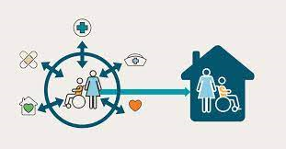
Preparing your home for discharge BEFORE surgery
Prepare meals and freeze ahead of time
Remove clutter and scatter rugs.
Create clear paths
Check the need for railings for stairs outside and within home or grab bars in the bathroom.
Confirm coach, transportation home and help at home following discharge
Notes:
How can you prepare your home for discharge even before you have your surgery? We know this may seem silly, but if you prepare your home prior to having surgery you will be better prepared and safer for discharge. Some things you can do is prepare and freeze meals ahead of time, remove clutter and scatter rugs, create clear paths for walking from room to room and check the need for railings for stairs outside or within the home or grab bars in the bathroom. Be sure to confirm your coach, transportation home and help at home following discharge from the hospital as you will have some limitations after surgery.

Slide 11
What to Expect: Day of Surgery
Arrive at the hospital & Register
You will be brought to the pre-op area by the nursing staff
Your surgeon will see you and answer any questions
You will be transferred to the Operating Room
You will wake up in the CVICU
Notes:
Please be sure you know the date and time of your surgery and where you should check in. Take instructed medications with a sip of water only the morning of your surgery. You will be given medication to make you drowsy and to decrease anxiety. Shortly after sedation a body shave will be done. You will then be taken to the OR where several monitoring lines will be inserted. Your family members should wait in the designated waiting room in the hospital. When surgery is completed, the surgeon will contact your family. Once you are settled in your room after surgery, your family may visit for a brief time. If there is a change in your condition, your family members will be contacted immediately as we believe that communicating with families is an important part of caring for patients.

Slide 12
What to Expect: During Surgery
During surgery an incision is made in the center of your chest from below your neck to below your breastbone, called your sternum
After the surgery has been completed, your surgeon wires your breastbone back together
These specially designed wires will remain in your chest
Your incision will be stitched together and covered with a dressing which will be changed by your nurse
Notes:
This is the timeline of what to expect during your surgery. Your surgery will require an incision along your chest from below your neck to below your breastbone, which is called the sternum. Once your surgery is complete, your breast bone will be put back together with stainless steel wires and sometimes plates. These instruments will remain in your chest. The incision will then be stitched together and covered by a dressing that is cared for by your nursing team.

Slide 13
What to Expect: Day of Surgery
The day of your surgery is called Post-op Day # Zero
The goal is to come off the breathing machine
If all criteria are met, you will be placed in a chair position while still in bed
If you can tolerate chair position in bed you may progress to a standing trial with your medical team assisting
After surgery you will be woken up in Cardiovascular ICU (CVICU)
Notes:
After your surgery is completed, you will be woken up in the CVICU. You will have many lines, tubes and drains attached to you, but those will all slowly be taken away throughout your recovery. The goal for POD#0 is to come off the breathing machine. Once that is accomplished, if all criteria is met after nursing assessment, you will be placed in a seated position in bed. If you are able to tolerate a seated position, you then may be progressed to a standing trial with your medical team assisting you.

Slide 14
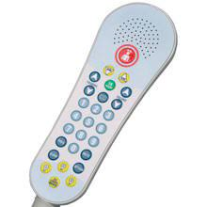
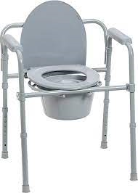

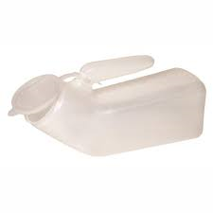
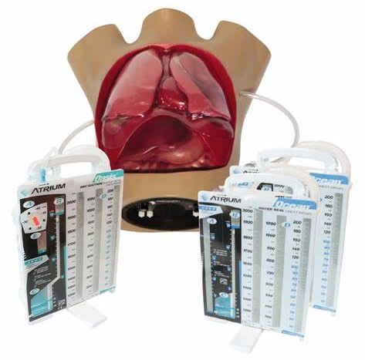
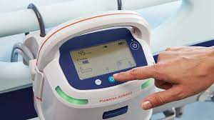
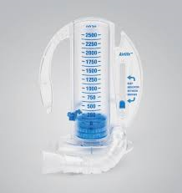
Equipment at the bedside
Notes:
This is some of the equipment you will see at the bedside. Starting at the top left picture is the call light that is used to call the nurse but also serves as the remote for the TV. Moving to the right you will see a commode and a urinal. In the cardiovascular ICU there are no bathrooms; however, you will have access to a commode or urinal until you are transferred to the cardiovascular step down unit where you will have your own bathroom. The last picture on the top row, is a heart pillow that will be used to assist with splinting when coughing or moving. Starting on the bottom left row is a picture of chest tubes which you will have attached to you when you wake up from surgery. The middle bottom picture is a pump that will be placed at the foot of your bed which attaches to compression boots to help prevent blood clots. The last picture is an incentive spirometer which will encourage you to take deep breaths, expand your lungs and prevent pneumonia.

Slide 15
Pain scale
Notes:
This is the pain scale that will be used to assess your pain. The scale goes from 0 to 10 and each number has a descriptor to help you better rate your pain. Incisions are uncomfortable for a few days and may remain sore for weeks. Pain medication will be provided for relief. Please let your nurse know if you are uncomfortable. As you move around and get out of bed after surgery, you will find that the incision will bother you less. The greatest source of your pain will likely be coming from your chest tubes so it is important to be up and moving as much as possible.

Slide 16
What to Expect: Morning after Surgery
The day after surgery is called Post-op Day # One
If all criteria are met, you will walk with nursing prior to breakfast
The goal will be out of bed and in the chair for most of the day
Everyone progresses at a different rate post-operatively so do not be discouraged if you don’t meet this criteria right away
Notes:
The day after your surgery is called post-op day 1. The goal of this day is to get you up and walking! If all criteria is met by nursing staff, they will have you out of bed and walking prior to breakfast. In some cases, you may only be able to be out of bed and transfer to the recliner and that is okay! Remember, everyone progresses differently after surgery, so do not be discouraged if you are not out of bed and walking right away!

Slide 17
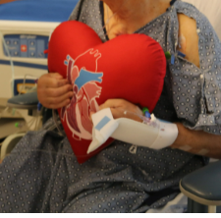
In-hospital Rehabilitation: Post-op Day #1
On Post-op Day#1, you will have your Physical Therapy (PT) Evaluation which includes:
Patient Interview
Strength and sensation assessment while in bed or in the recliner
Walking and activity tolerance assessment
The Goal: Stand and walk the length of the hallway or to the best of your ability with the assistance of your Physical Therapist and nursing staff.
Notes:
Another goal of post-op day one, is to have a physical therapy evaluation. Your PT will ask questions in regard to your function prior to surgery, your home set-up, and your support system. They will then assess your strength and sensation, attempt exercises and then get your walking in the unit. The goal for PT is to have you walking the length of the hallway to the best of your ability with assistance of your nursing team as well.

Slide 18
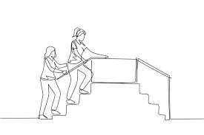
In-hospital Rehabilitation
You will be seen by Physical Therapy every day (including the weekends) until discharged from the hospital or your therapy goals have been met
It is expected for you to be out of bed and in the recliner every day and throughout the entire day, especially for meals.
You will walk 4 times a day – everyday
Once you are considered appropriate to transition to a less acute stage of monitoring, you will transfer to the Cardiovascular Step-Down Unit to continue your recovery.
Physical Therapy will focus on:
Bed mobility
Transfers
Walking
Climbing the Stairs
Upper Body and Lower Body Strengthening
Endurance Training
Notes:
After your initial evaluation from PT, you will be asked to walk at minimum 4x/day with your care team. Walking and time OOB is vital to your recovery after your surgery. Physical therapy will focus on more functional tasks such as getting in and out of bed, on and off surfaces, climbing stairs and exercises to help you with your strength, endurance and balance, which you will notice will improve daily!

Slide 19
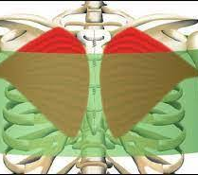
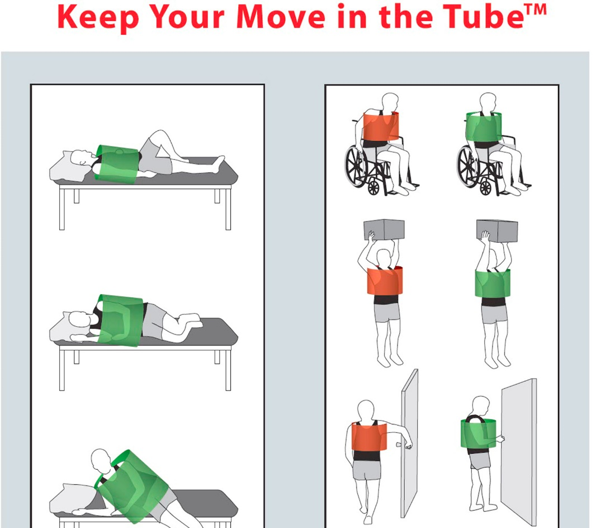
“Keep your Move in the Tube”
Notes:
Patients: The diagram above is placed in every patient room for reference. The green sphere shows the correct way to perform tasks in comparison to the red sphere, which is what you should refrain from doing. In general, you want to imagine that there is an imaginary tube placed around your upper chest and arms and when you are weight bearing or holding anything less than 10 lbs (or a gallon of milk), you want to keep that movement within your imaginary tube. You are allowed to reach over your head and down to your toes while WB, as well as push yourself up from the surface you are sitting on, but as long as your arms are staying close to your sides or within your tube. If you are not WB or lifting any objects, you are allowed to move outside that tube within your comfort.

Slide 20
Why “Move within the Tube?”
Reduces strain on the breastbone
Stabilizes the breastbone
Reduces risk of infection
Reduces length of stay in the hospital
Reduces re-admission
Reduces pain
3x Increase in the likelihood of home discharge
Less home services
Improved functional performance from initial evaluation to final treatment session
Previously used sternal precautions were found to be:
Restrictive and functionally limiting
Prohibit common shoulder joint and shoulder girdle movement
Reinforces fear of activity which leads to substantial muscle atrophy that occurs during short-term disability
May decrease quality of life
May delay discharge
May be unable to return home
Notes:
The standard sternal precautions are being phased out and many facilities are moving towards a less restrictive approach. This is because ^
As a hospital system, we have adopted a less restrictive idea of movement to help assist you as the patient to be more (I) while recovering from your surgery. This newer concept is called, “Keep Your Move In The Tube”. This transition is occurring at this facility because research has shown that ^

Slide 21
Moving within the Tube
For weightbearing activities:
While weightbearing, we advise you to keep your move in the tube.
The idea is not to put stress on the wires that are used to hold the sternum together while it heals.
Keep your elbows at your side and stay within the tube.
For non-weightbearing activities:
If you are not bearing any weight or lifting with your arms you can move outside the tube
This includes reaching above your head and performing functional tasks such as:
Upper and lower body bathing/dressing
Undergarments, compression stockings, etc
Reaching overhead for lightweight miscellaneous needs
Please avoid any positions that cause increased discomfort or pain
Notes:
Patients: The reason for the 10 lb weight limitation for within the tube movements, is so that you can avoid adding stress onto the wires that are helping to hold your sternum together while it heals. Again, we emphasize that if you are at all WB, you should remain in your tube and keep you elbows at your side.
For nonWB activities, we encourage you to move freely so that you can return to a more functional state of being. This includes: UB and LB dressing/bathing, placing your own undergarments on or even grabbing a coffee mug from a top shelf. Now if you are in pain with any of these non WB motions, we do advise that you listen to your body and avoid that activity until your pain is more controlled.

Slide 22

Discharge- What Now?
The goals for you as the patient at time of discharge are:
To be independent with bed mobility, transfers, ambulation and stairs (if applicable)
Ambulating functional home or community distances without an assistive device unless clearance received
Maintain your “Keep your Move in the Tube” precautions without cues
Pain is within a controlled range that is suitable for home discharge
Independent with pacing strategies with mobility
Notes:
After your medical and physical rehabilitation, it is time for DC…so now what? We hope by the time of your DC, you have achieved a mobility status where you are able to be (I) with bed mobility, transfers and walking….

Slide 23
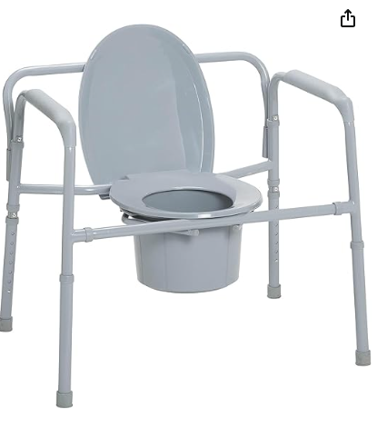
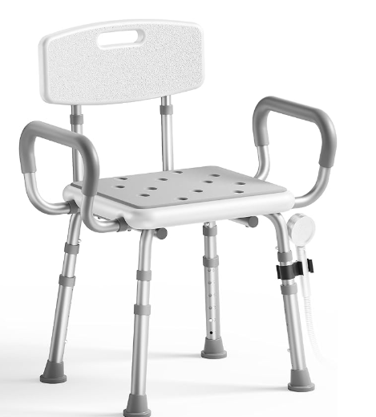
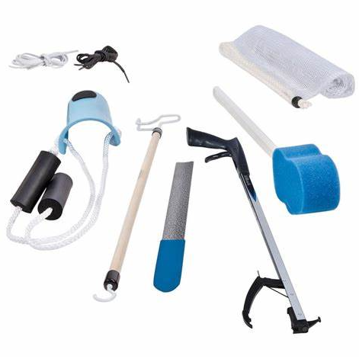
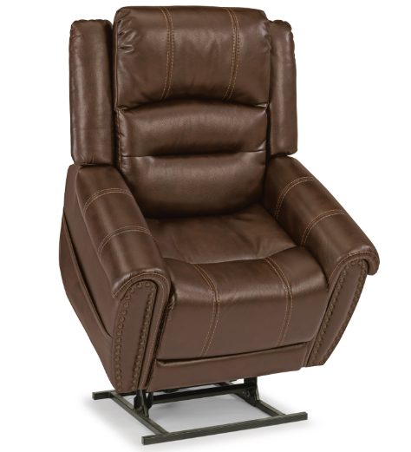
Durable Medical Equipment
What if I am not independent?!
+ If you are unable to perform certain tasks without assistance, Physical Therapy and/or Occupational Therapy (OT) will review equipment or other strategies that may assist you and your coach to allow you to complete these tasks safely and with more ease.
Notes:
If you are not independent with certain tasks, PT and OT will review the equipment you see in this slide that can aide in your independence. They will work with your coach as well and assist with training any of your caregivers and yourself to help you be as independent as possible with hopes of you going home after surgery.

Slide 24

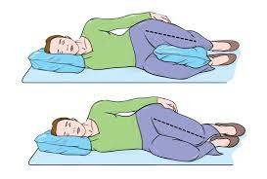
Car Transfers & sleeping positions
It is okay to sit in the front passenger seat
You do not need to disengage the airbags to sit in the front seat
Place your heart pillow between your chest and the seat belt to protect your incision
Discuss with your surgeon when you may be able to begin driving
You do not need to sleep on your back and IT IS okay to sleep on your side
For comfort, place a pillow behind your back for support and a pillow between your knees
Notes:
Also, in regards to car transfers and sleeping….

Slide 25

Discharge
rehab discharge
Home discharge
If there are no barriers to discharge, you will be expected to go home with your family/friends or with the support of your “coach”.
Your care coordinator will set-up any additional services or equipment you may need.
Your nursing team will provide appropriate discharge paperwork that they will review with you.
If you are unable to return home at the time you are medically ready to discharge,
You will continue your medical and physical rehabilitation at a facility equipped to assist you with your needs with hopes of you returning home quickly!
Notes:
If there are no barriers to your DC, the expectation is for you to be DC home with your “coach” or family..
If you are unable to return home due to particular barriers, we will place a referral to an acute rehab or SNF to continue your medical and physical rehabilitation with the goal of returning you home in the near future!

Slide 26

Thank you!
We look forward to meeting you soon! Please reach out to your Cardiothoracic Team/Provider if there are any questions or concerns after this presentation.
Notes:
We appreciate your participation in our virtual pre-op presentation. We hope this eases your mind and prepares you for your upcoming surgery. We look forward to meeting you soon and assisting you with your recovery. If you have any questions, please reach out to your Cardiothoracic team and/or provider. Thank you

Slide 27
References
Adams, J., Lotshaw, A., Exum, E., Campbell, M., Spranger, C. B., Beveridge, J., . . . Schussler, J. M. (2016). An Alternative Approach to Prescribing Sternal Precautions After Median Sternotomy, “Keep Your Move in the Tube”. Baylor University Medical Center Proceedings, 29(1), 97-100. doi:10.1080/08998280.2016.11929379
Adams, J., PhD, Cahalin, L. P., PhD, PT, CCS, & BAppAx, D. E., PhD. (2017). Get SMART for Heart & Keep Your Move in teh Tube: Evidence-Based Practice [Scholarly project]. In APTA CSM. Retrieved February 1, 2021, from https://cdn.ymaws.com/www.aptaacutecare.org/resource/resmgr/csm/Cahalin_SM_2017_Sternal__Pre.pdf
Coltman, C., Park, L., Colwell, S., Agren, H., & King-Shier, K. (2019). Keep Your Move in the Tube: Breaking down the restricted walls of movement post-sternotomy [Abstract]. Canadian Journal of Cardiology, 35, S205-S206. Retrieved February 1, 2021.
Gach, R., Triano, S., Ogola, G. O., Graca, B. D., Shannon, J., El‐Ansary, D., . . . Adams, J. (2021). “ Keep Your Move in the Tube ” safely increases discharge home following cardiac surgery. Pm&r, 1-9. doi:10.1002/pmrj.12562
News, I. B. (2019, May 08). Retrieved February 01, 2021, from https://www.ivanhoe.com/medical-breakthroughs/keep-your-move-in-the-tube-during-heart-rehab/
Radfar, J., Fuchs, L., & Cahalin, L. P. (2019). An alternative approach to sternal precautions improves length of stay after median sternotomy [Abstract]. Cardiovascular and Pulmonary Section, APTA. Retrieved February 1, 2021.
Stuebe, J., Rydingsward, J., Lander, H., Ng, J., Xu, X., Kaneko, T., . . . Body, S. C. (2018). A Pragmatic Preoperative Prediction Score for Nonhome Discharge After Cardiac Operations. The Annals of Thoracic Surgery, 105(5), 1384-1391. doi:10.1016/j.athoracsur.2017.11.060
Ley J, El-Ansary D, Katijjahbe MA, Adams J, Triano S, Gach R. Goodbye Sternal Precautions, Hello Move in the Tube? April 2019. doi:10.25373/ctsnet.8001731.

